Slide 1


Alekhya Machiraju
4/13/2022

Slide 2

Executive Summary
The SpaceX project used the Data Science methodology involving data collection, data wrangling, exploratory data analysis, data visualization, model development, model evaluation, and reporting the results.

Slide 3
Introduction
In this modern age of science Virgin Galactic is providing suborbital spaceflights. Rocket Lab is a small satellite provider. Blue Origin manufactures sub-orbital and orbital reusable rockets. The most successful is SpaceX. SpaceX’s accomplishments include Sending spacecraft to the International Space Station. Starlink, a satellite internet constellation providing satellite Internet access. Sending manned missions to Space. One reason SpaceX can do this is the rocket launches are relatively inexpensive. SpaceX advertises Falcon 9 rocket launches on its website with a cost of 62 million dollars; other providers cost upwards of 165 million dollars each, much of the savings is because SpaceX can reuse the first stage.

Slide 4

Section 1

Slide 5
Methodology
Executive Summary
Data collection methodology:
SpaceX Rest API
Web scrapping from wikipedia
Perform data wrangling
Cleaning of irrelevant data and null values.
Hot encoding data fields.
Perform exploratory data analysis (EDA) using visualization and SQL
Perform interactive visual analytics using Folium and Plotly Dash
Perform predictive analysis using classification models
LR,KNN,SVM,DT models have been used.

Slide 6
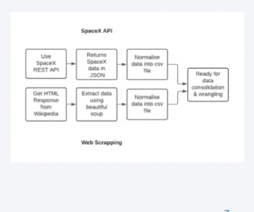
Data Collection
Datasets collected are :
Spacex launch data that is generated from the SpaceX Rest Api.
The spaceX REST API endpoints or URL.
Falcon 9 launch data is web scraping Wikipedia using BeautifulSoup.

Slide 7
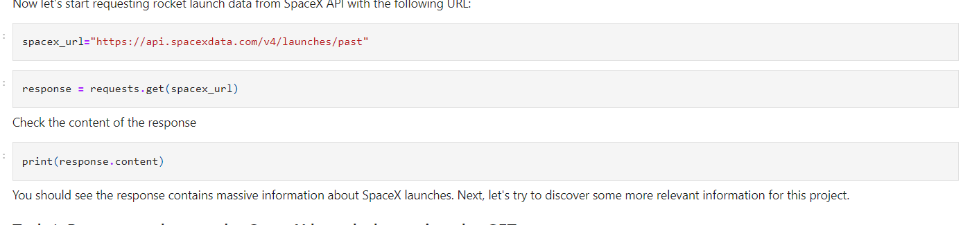
Data Collection – SpaceX API
Data Collection with spacex REST Api calls
https://github.com/AlekhyaMachiraju-lab/testrepo/blob/main/jupyter-labs-spacex-data-collection-api.ipynb
Place your flowchart of SpaceX API calls here

Slide 8
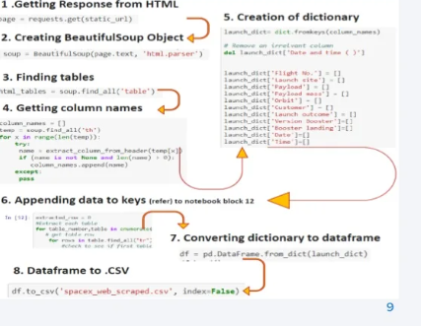
Data Collection - Scraping
Webscrapping from Wikipedia
https://github.com/AlekhyaMachiraju-lab/testrepo/blob/main/jupyter-labs-webscraping.ipynb
Place your flowchart of web scraping here

Slide 9
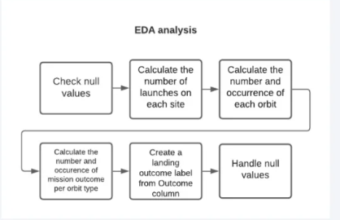
Data Wrangling
https://github.com/AlekhyaMachiraju-lab/testrepo/blob/main/labs-jupyter-spacex-Data%20wrangling.ipynb

Slide 10


EDA with Data Visualization
EDA with Data Visualization
We explored the data by visualizing the relationship between flight number and launch Site, payload and launch site, success rate of each orbit type, flight number and orbit type, the launch success yearly trend.
The link to the notebook is https://github.com/AlekhyaMachiraju-lab/testrepo/blob/main/EDA%20with%20Data%20Visualization.ipynb
10

Slide 11
EDA with SQL
We loaded the SpaceX dataset into a PostgreSQL database without leaving the jupyter notebook.
We applied EDA with SQL to get insight from the data. We wrote queries to find out for instance:
The names of unique launch sites in the space mission.
The total payload mass carried by boosters launched by NASA (CRS)
The average payload mass carried by booster version F9 v1.1
The total number of successful and failure mission outcomes
The failed landing outcomes in drone ship, their booster version and launch site names.
The link to the notebook is https://github.com/AlekhyaMachiraju-lab/testrepo/blob/main/EDA%20with%20SQL.ipynb

Slide 12
Build an Interactive Map with Folium
We marked all launch sites, and added map objects such as markers, circles, lines to mark the success or failure of launches for each site on the folium map.
We assigned the feature launch outcomes (failure or success) to class 0 and 1.i.e., 0 for failure, and 1 for success.
Using the color-labeled marker clusters, we identified which launch sites have relatively high success rate.
We calculated the distances between a launch site to its proximities. We answered some question for instance:
Are launch sites near railways, highways and coastlines.
Do launch sites keep certain distance away from cities.

Slide 13
Build a Dashboard with Plotly Dash
We built an interactive dashboard with Plotly dash
We plotted pie charts showing the total launches by a certain sites
We plotted scatter graph showing the relationship with Outcome and Payload Mass (Kg) for the different booster version.
The link to the notebook is https://github.com/AlekhyaMachiraju-lab/testrepo/blob/main/app.py

Slide 14
Predictive Analysis (Classification)
We loaded the data using numpy and pandas, transformed the data, split our data into training and testing.
We built different machine learning models and tune different hyperparameters using GridSearchCV.
We used accuracy as the metric for our model, improved the model using feature engineering and algorithm tuning.
We found the best performing classification model.
The link to the notebook is https://github.com/AlekhyaMachiraju-lab/testrepo/blob/main/Machine%20Learning%20Prediction.ipynb

Slide 15
Results
Exploratory data analysis results
Interactive analytics demo in screenshots
Predictive analysis results

Slide 16

Section 2

Slide 17

Flight Number vs. Launch Site
Flight Number vs. Launch Site
From the plot, we found that the larger the flight amount at a launch site, the greater the success rate at a launch site.
17

Slide 18


Payload vs. Launch Site
Payload vs. Launch Site
18

Slide 19

Success Rate vs. Orbit Type
Success Rate vs. Orbit Type
From the plot, we can see that ES-L1, GEO, HEO, SSO, VLEO had the most success rate.
19

Slide 20

Flight Number vs. Orbit Type
Flight Number vs. Orbit Type
The plot below shows the Flight Number vs. Orbit type. We observe that in the LEO orbit, success is related to the number of flights whereas in the GTO orbit, there is no relationship between flight number and the orbit.
20

Slide 21

Payload vs. Orbit Type
Payload vs. Orbit Type
We can observe that with heavy payloads, the successful landing are more for PO, LEO and ISS orbits.
21

Slide 22
Launch Success Yearly Trend
Launch Success Yearly Trend
From the plot, we can observe that success rate since 2013 kept on increasing till 2020.
22

Slide 23

All Launch Site Names
All Launch Site Names
We used the key word DISTINCT to show only unique launch sites from the SpaceX data.
23

Slide 24

Launch Site Names Begin with 'CCA'
Launch Site Names Begin with 'CCA'
We used the query above to display 5 records where launch sites begin with `CCA`
24

Slide 25

Total Payload Mass
Total Payload Mass
We calculated the total payload carried by boosters from NASA as 45596 using the query below
25

Slide 26

Average Payload Mass by F9 v1.1
We calculated the average payload mass carried by booster version F9 v1.1 as 2928.4
26

Slide 27

First Successful Ground Landing Date
First Successful Ground Landing Date
We observed that the dates of the first successful landing outcome on ground pad was 22nd December 2015
27

Slide 28

Successful Drone Ship Landing with Payload between 4000 and 6000
Successful Drone Ship Landing with Payload between 4000 and 6000
We used the WHERE clause to filter for boosters which have successfully landed on drone ship and applied the AND condition to determine successful landing with payload mass greater than 4000 but less than 6000
28

Slide 29

Total Number of Successful and Failure Mission Outcomes
Total Number of Successful and Failure Mission Outcomes
We used wildcard like ‘%’ to filter for WHERE MissionOutcome was a success or a failure.
29

Slide 30

Boosters Carried Maximum Payload
Boosters Carried Maximum Payload
We determined the booster that have carried the maximum payload using a subquery in the WHERE clause and the MAX() function.
30

Slide 31

2015 Launch Records
2015 Launch Records
We used a combinations of the WHERE clause, LIKE, AND, and BETWEEN conditions to filter for failed landing outcomes in drone ship, their booster versions, and launch site names for year 2015
31

Slide 32

Rank Landing Outcomes Between 2010-06-04 and 2017-03-20
Rank Landing Outcomes Between 2010-06-04 and 2017-03-20
We selected Landing outcomes and the COUNT of landing outcomes from the data and used the WHERE clause to filter for landing outcomes BETWEEN 2010-06-04 to 2010-03-20.
We applied the GROUP BY clause to group the landing outcomes and the ORDER BY clause to order the grouped landing outcome in descending order.
32

Slide 33

Section 3

Slide 34

<Folium Map Screenshot 1>
All launch sites global map markers
34

Slide 35

Markers showing launch sites with color labels
35

Slide 36

Launch Site distance to landmarks
36

Slide 37

Section 4

Slide 38

Pie chart showing the success percentage achieved by each launch site
38

Slide 39

Pie chart showing the Launch site with the highest launch success ratio
39

Slide 40

Scatter plot of Payload vs Launch Outcome for all sites, with different payload selected in the range slider
40

Slide 41

Section 5

Slide 42

Classification Accuracy
Classification Accuracy
The decision tree classifier is the model with the highest classification accuracy
42

Slide 43

Confusion Matrix
Confusion Matrix
The confusion matrix for the decision tree classifier shows that the classifier can distinguish between the different classes. The major problem is the false positives .i.e., unsuccessful landing marked as successful landing by the classifier.
43

Slide 44
Conclusions
We can conclude that:
The larger the flight amount at a launch site, the greater the success rate at a launch site.
Launch success rate started to increase in 2013 till 2020.
Orbits ES-L1, GEO, HEO, SSO, VLEO had the most success rate.
KSC LC-39A had the most successful launches of any sites.
The Decision tree classifier is the best machine learning algorithm for this task.
44

Slide 45


